Slide 1
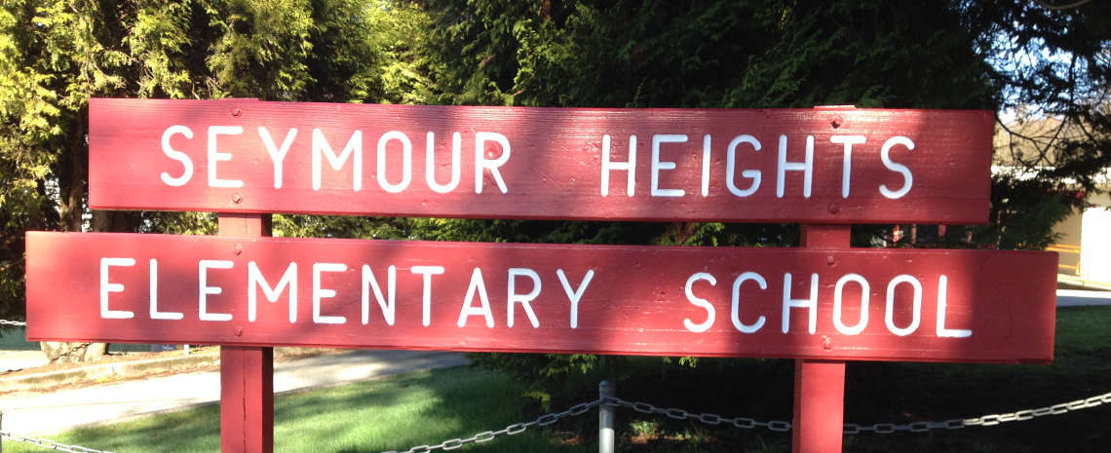
Meet the Teacher
2023-2024
Division 3
Grade 5/6

Slide 2
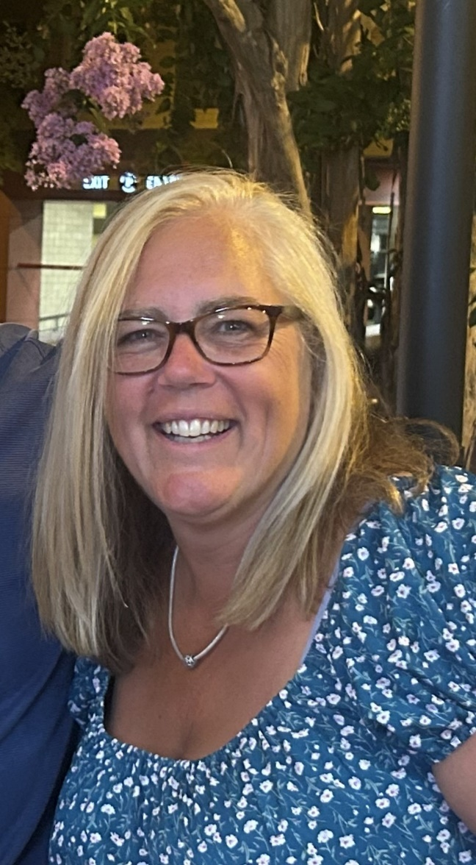
Mrs. Kathleen Baker
kbaker@sd44.ca
http://mrsbakersclasswebsite.weebly.com/

Slide 3
Class Website
-planner information
-longer assignments
-work samples
-rubrics
-late work tab

Slide 4
Our Schedule

Slide 5
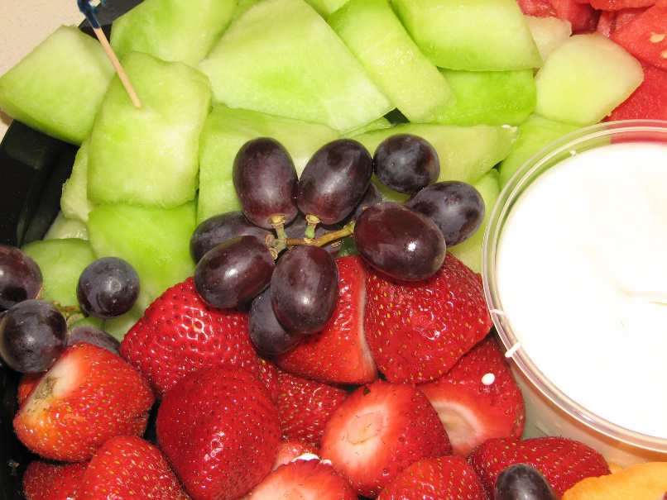
Snacks
Students are allowed to eat snacks during school
if it is a healthy choice.
Birthdays
Birthdays are celebrated with a desk ornament and a choice from the birthday bin. If you would like to send a birthday treat for the class, please send a nut-free option. We presently have 26 students in the class.

Slide 6
Homework
I do not assign regular homework. If your child does not
finish work during class time, it is expected to be taken
home to be completed. Students are allowed to work on incomplete work right after lunch each day, as well.
At times, longer assignments will be
given which might result in your child
needing to complete some work at home.

Slide 7
Ways to support your child at home:
-encourage your child to read for a minimum
of twenty minutes each day
-practise basic math facts to develop fluency
(addition, subtraction, multiplication, division)
through review, mental math, games,
etc.
-regularly check your child’s planner/agenda

Slide 8
How can your child be accountable
for their own learning?
-ask for help when needed
-check missed work folder
-use planner/agenda
-complete assignments by assigned dates
-check website for assignments and due dates,
if unsure
-listen and participate
-put forth full effort

Slide 9
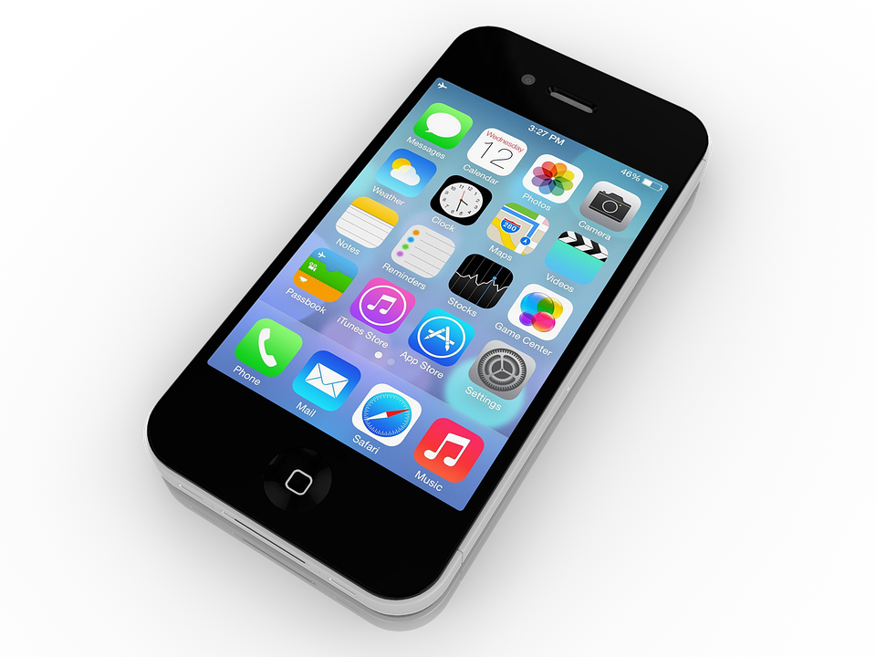
Technology
Cell phones/technology should be in backpacks or at home
during the entire school day.
Seymour Heights has laptops and iPads for students to use
and for research.
Students can use the school phone if they need to
contact parents.
The school is not responsible for lost or damaged
personal technology.

Slide 11
Please do not hesitate to contact me if you have any questions or concerns.
It is very important to me to develop strong relationships with my students’ families. I am here to help!

